Slide 1
Word Wealth Unit 7
Adjectives and Nouns

Slide 2
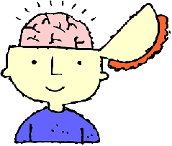
Acute
Sharp, severe, perceptive
Related Words:
Discernment-Clear seeing)
Astuteness-mental sharpness
ACUTE ANGLE

Slide 3
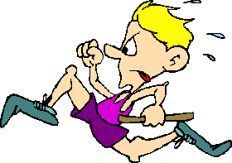
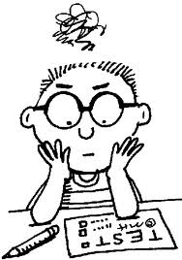
Agile
Nimble, quick, skillful

Slide 4
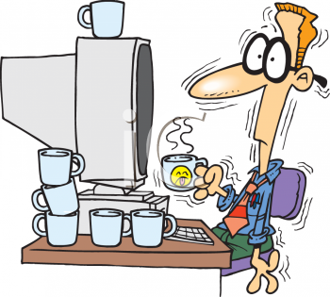
Erratic
Irregular, wandering, having no fixed course
Err- to wander from the path of virtue or truth
Erroneous-wrong, devious, mistaken

Slide 5
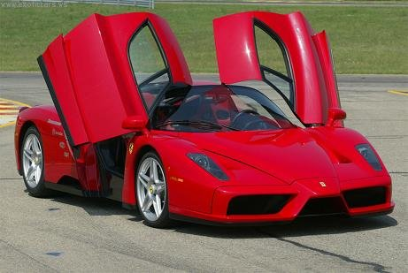
Exorbitant
Excessive, unreasonable (in what one asks)
Related Words:
Extravagant-lavish
Immoderate- not sufficiently restrained

Slide 6
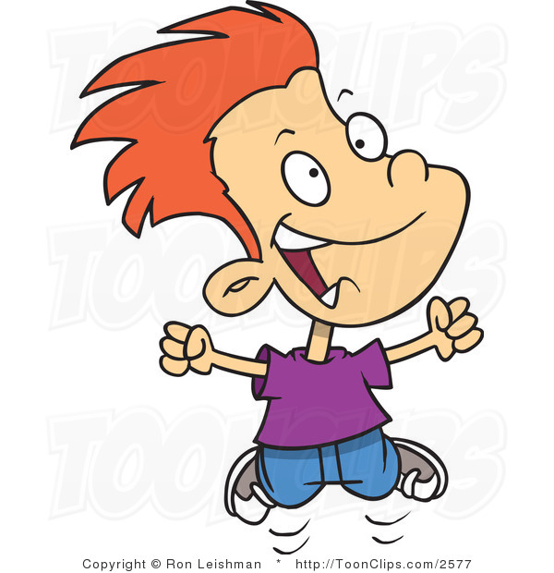
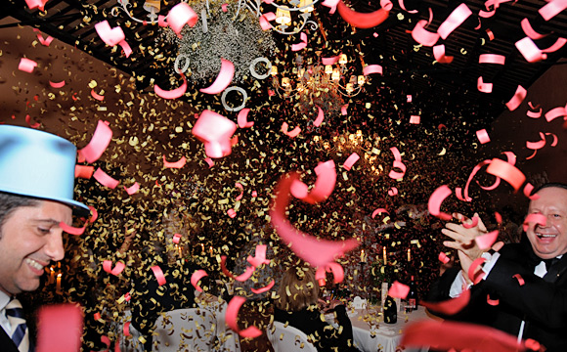
Exultant
Joyful, jubilant
Related Words:
Jubilee- a celebration
Jocund- manner that is cheerful but not quite exultant

Slide 7
Implicit
Unquestioning, implied
Explicit- clearly stated

Slide 8
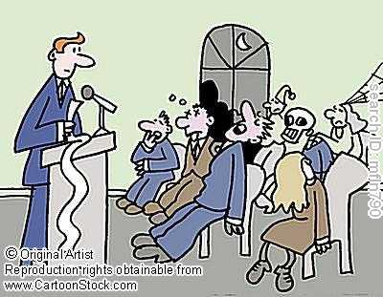
Inane
Senseless, empty
Both political speeches were filled with inanities.

Slide 9
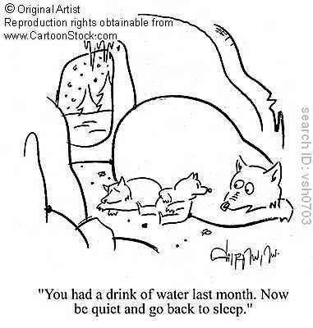
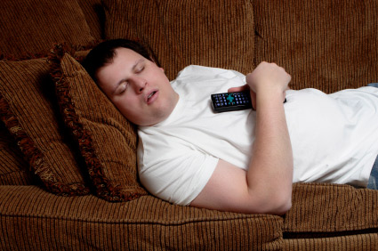
Inert
Inactive or lifeless
Related Words:
Passive-unwilling to act or lead
Indolent-lazy
Listless-indifferent, uninterested (languid)
Dormant- temporary inactivity (like sleep)

Slide 10
Inferior
Lower in place or quality

Slide 11
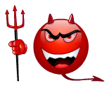
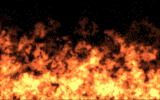
Infernal
Hellish, fiendish
Related Words:
Diabolic(al)- scheme is devilish
Execrations-curses

Slide 12
Nouns-Fugitive
One who flees, a runaway
Related words:
Refugee-flees from homeland to escape danger
Elusiveness-quality that makes a fugitive hard to catch
Evasiveness-skill in dodging something

Slide 13
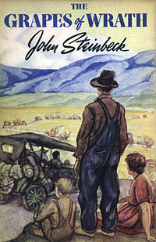
Indignation
Justifiable anger
Related Words :
Vexation- strong annoyance
Wrath- fury, intense anger with the desire to punish or revenge
Animosity- strong hostility (usually personal)

Slide 14
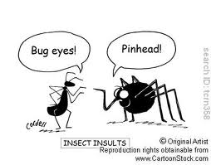
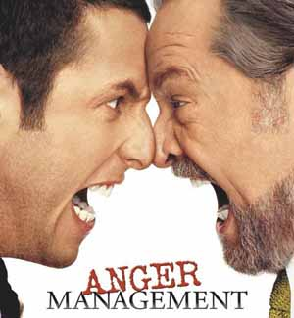
Insolence
Insulting behavior, impudence (self-superior)

Slide 15
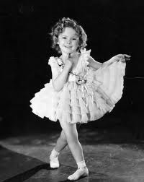
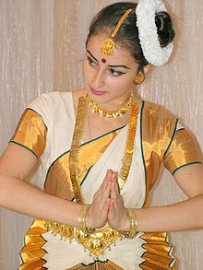
Obeisance
A bow or curtsy, respect
Related Words:
Genuflection: knee-bending in worship
Salaam-(Middle-Eastern) low bow
Kow-tow-Chinese kind of obeisance

Slide 16
Repose
Rest, quiet
Related Words:
Repository- place of storage for ideas, objects, or materials

Slide 17
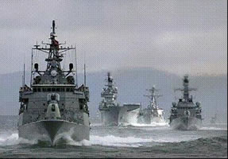
Retinue
A group of attendants
Convoy- protecting escort at sea or a group of ships being escorted

Slide 18
Sanction
Approval, authorization
Related Words:
Warrant- order by a government agency
Dispensation- approval by the church for some variation from its laws
Condonation- approval of something by overlooking it.

Slide 19
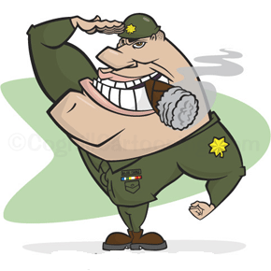
Strategy
Skill in maneuvering or planning
Related Words:
In military terms-strategy includes methods and plans in the largest sense/tactics- specific devices and operations

Slide 20
Succor
Aid, help

Slide 21
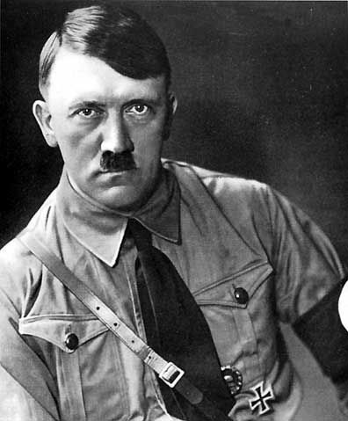
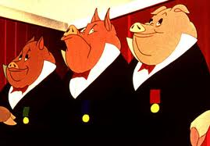
Tyrrany
Oppressive or unjust government
Related Words:
Autocrat- tyrannical person
Dictator- a tyrant who seizes power and does not pass it to a successor in a family line
Despot- tyrant belonging to a regular line of succession (like Louis the XIV of France)

